Slide 1
Computer Networks
Unit 1
By
Dr. Vivek Rajpoot
Assistant Professor
Dept. of Electronics and Communication Engineering
Aditya College of Engineering & Technology
Surampalem

Slide 2
Flow of Discussion
Introduction
Network Topology
LAN
MAN
WAN
Reference Models
OSI Reference Model
TCP/IP Reference Model
Comparison of Reference models
Dr. Vivek Rajpoot
Unit-1

Slide 3
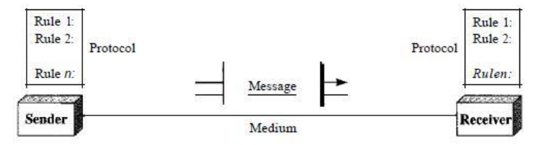
Introduction
Computer Network: A computer network is a set of computers connected together for the purpose of sharing resources.
Examples:
The most common resource shared today is connection to the Internet.
Other shared resources can include a printer or a file server.
Components:
Sender
Receiver
Message
Channel (Medium)
Protocols
Dr. Vivek Rajpoot
Unit-1

Slide 4
Introduction
Data Flow:
Simplex: one way communication and one end (Ex- Keyboard),
Half Duplex: One way both ends (Ex- Walkie-Talkie)
Duplex: Both way both ends simultaneously (Ex- Telephones)
Network: In a network devices (often referred to as nodes) connected by communication links.
A node can be a computer, printer, or any other device capable of sending and/or receiving data generated by other nodes on the network.
Most networks use distributed processing, i.e. a task is divided among multiple computers. Instead of one single large machine being responsible for all aspects of a process.
Dr. Vivek Rajpoot
Unit-1

Slide 5
Introduction
Network Criteria: Performance, Reliability, and Security.
Performance:
Transit time: is the time required for a message to travel from one device to another.
Response time: is the elapsed time between an inquiry and a response.
The performance depends on factors like, number of users, the type of transmission medium, the capabilities of hardware, and the efficiency of the software.
Performance is often evaluated by two networking metrics: throughput and delay. (More throughput and less delay)
If we try to send more data to the network, we may increase throughput but we increase the delay because of traffic congestion in the network.
Dr. Vivek Rajpoot
Unit-1

Slide 6
Introduction
Network Criteria: Reliability, and Security.
Reliability:
Accuracy of delivery, network reliability is measured by the frequency of failure, the time it takes a link to recover from a failure, and the network's robustness in a catastrophe.
Security:
Network security issues include protecting data from unauthorized access, protecting data from damage and development, and implementing policies and procedures for recovery from breaches and data losses.
Dr. Vivek Rajpoot
Unit-1

Slide 7
Network Topology
Types of Connection:
Point to Point: A point-to-point connection provides a dedicated link between two devices. The entire capacity of the link is reserved for transmission between those two devices. Most point-to-point connections use an actual length of wire or cable to connect the two ends, but other options, such as microwave or satellite links, are also possible.
Multipoint: also called multidrop connection, it is one in which more than two specific devices share a single link.
The capacity of the channel is shared, either spatially or temporally. If several devices can use the link simultaneously, it is a spatially shared connection. If users must take turns, it is a timeshared connection.
Dr. Vivek Rajpoot
Unit-1

Slide 8
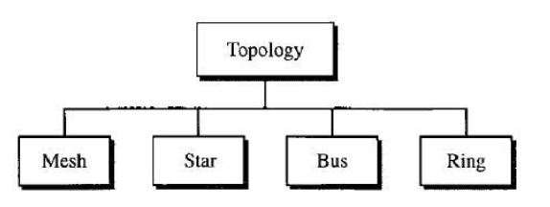
Network Topology
Topology: The term physical topology refers to the way in which a network is laid out physically.
One or more devices connect to a link; two or more links form a topology. The topology of a network is the geometric representation of the relationship of all the links and linking devices
Types:
Dr. Vivek Rajpoot
Unit-1

Slide 9
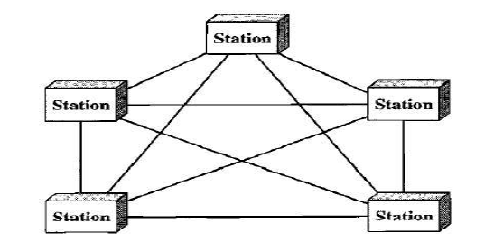
Network Topology
Mesh Topology: every device has a dedicated point-to-point link to every other device.
The term dedicated means that the link carries traffic only between the two devices it connects.
No. of half duplex links = n(n-1)
No. of Full Duplex links = n(n-1)/2
Advantages
Guaranteed connection
Link failure not affect network
Privacy and security
Fault detection and correction
Disadvantages
Too much hardware, Installation cost is high, reconnection is difficult.
Dr. Vivek Rajpoot
Unit-1

Slide 10
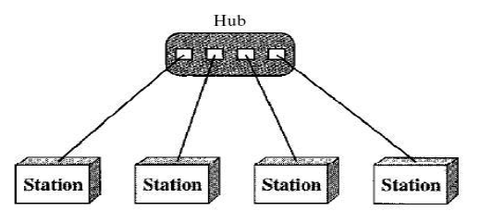
Network Topology
Star Topology: Each device has a dedicated point-to-point link only to a central
controller, usually called a hub.
The devices are not directly linked to one
The Hub acts as an Exchange
Advantages
Less expensive than a mesh topology
easy to install and reconfigure.
Adding Deletion of link is easy
Robustness: If one link fails, only that link is affected
Disadvantages: If hub goes down complete failure.
Hub should be very powerful in processing.
Dr. Vivek Rajpoot
Unit-1

Slide 11
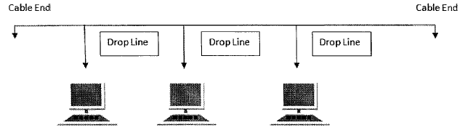
Network Topology
Bus Topology: A bus topology has multipoint connection where one long cable acts as a backbone to link all the devices in a network.
The Nodes are connected to the bus cable by drop lines.
First technology of LAN.
Advantages
Easy to install, easy to expand.
Least cable required.
Used in small networks.
Disadvantages: If cable blocks or congested whole network fails.
Limited no. of nodes can be connected otherwise congestion.
Slow and performance is limited by bandwidth of cable.
Dr. Vivek Rajpoot
Unit-1

Slide 12
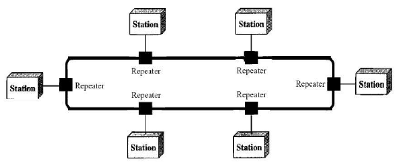
Network Topology
Ring Topology: each device has a dedicated point-to-point connection with
only the two devices on either side of it.
One direction flow until data reaches its destination.
Device are connected through repeater.
Advantages
easy to install and reconfigure
Fault detection is easy (Message)
Add or deletion needs two links to change
Disadvantages: unidirectional traffic
A ring break can disable the entire network.
Dual Ring is used to overcome the issue, Token ring is advance form.
Dr. Vivek Rajpoot
Unit-1

Slide 13
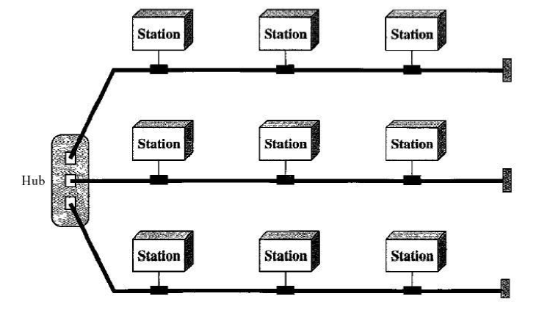
Network Topology
Hybrid Topology: Hybrid Topology A network can be hybrid.
Hybrid means use of multiple technology simultaneously.
Example hybrid of star and bus topology.
Dr. Vivek Rajpoot
Unit-1

Slide 14
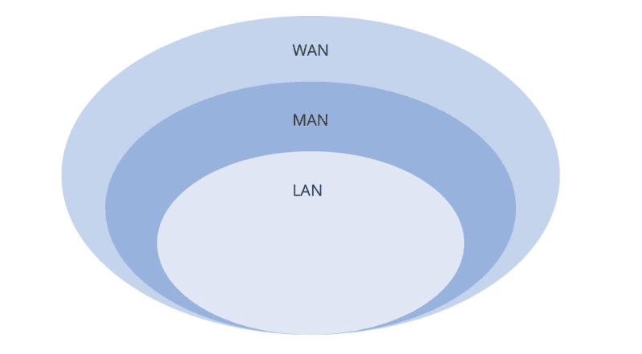
Network Types
Network Category depends on its size
Three primary categories
LAN: Covers area (up to 1km
MAN: Between LAN & WAN. (covers on city 10 km)
WAN: Can be worldwide
Dr. Vivek Rajpoot
Unit-1

Slide 15
Local Area Network (LAN)
Privately owned
Links devices in the same office, building, or campus
Simple LAN: 2 PCs & 1 printer in home or office
Size is limited to a few kilometers
Allow resources to be shared (hardware, software, or data)
LAN is distinguished by:
Size (# users of OS, or licensing restrictions)
Transmission medium (only one type)
Topology (bus, ring, star)
Ethernet : IEEE 802.3, popularly called Ethernet, it is a bus-based broadcast network with decentralized control, usually operating at 10 Mbps to 10 Gbps
IEEE 802.5 (the IBM token ring), is a ring-based LAN operating at 4 and 16 Mbps
Data Rates (speed):
Early: 4 to 16 Mbps
Today: 100 Mbps to 1 Gbps or 10 Gbps
Dr. Vivek Rajpoot
Unit-1

Slide 16
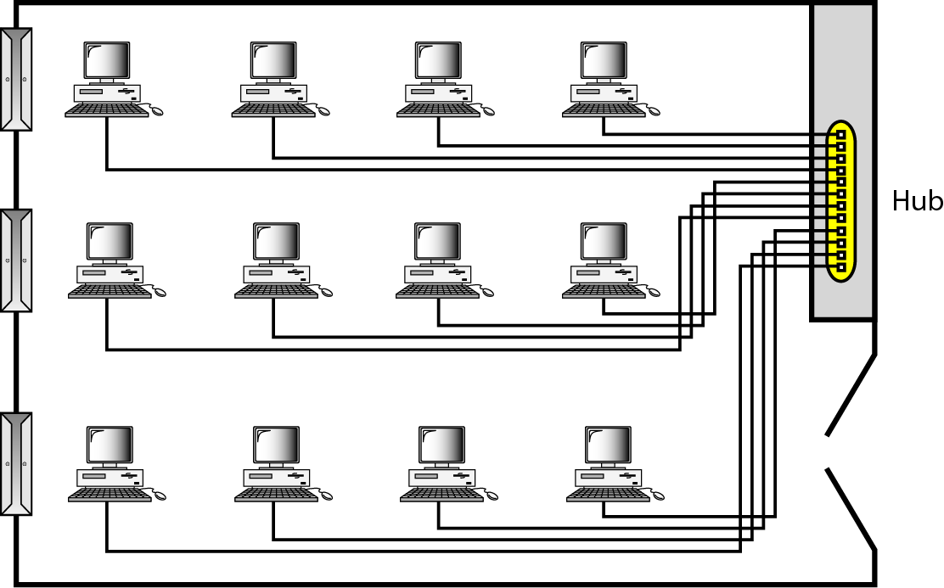
Local Area Network (LAN)
Dr. Vivek Rajpoot
Unit-1

Slide 17
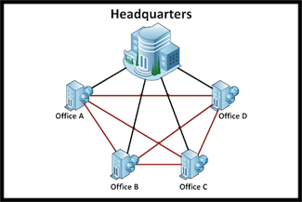
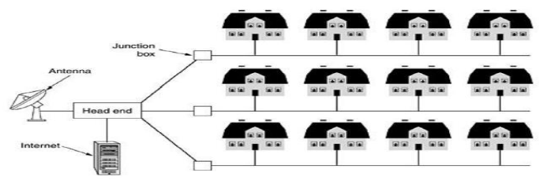
Metropolitan Area Networks (MAN)
Size between LAN and WAN
Inside a town or a city
Example: Cable TV network inside a city
Dr. Vivek Rajpoot
Unit-1

Slide 18
Metropolitan Area Networks (MAN)
This system grew from community antenna systems used in areas with poor over-the-air television reception.
A large antenna was placed on top of a nearby hill and signal was then piped to the subscribers‘ houses or to wire up an entire city.
Recent developments in high-speed wireless Internet access resulted in another MAN, which has been standardized as IEEE 802.16.
Dr. Vivek Rajpoot
Unit-1

Slide 19
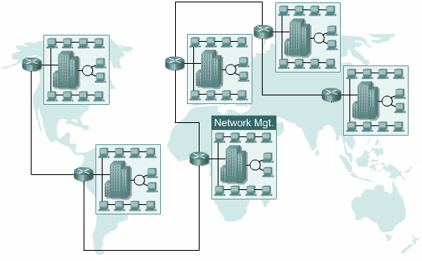
Wide Area Networks (WAN)
Provides long-distance transmission of data over large geographic areas (country, continent, world).
It contains a collection of machines/Hosts intended for running user (i.e., application) programs.
The hosts are connected by a
communication subnet, or just
Subnet for short.
Hosts are owned by customers
& communication subnet is owned
and operated by telephone company
or Internet service provider.
Dr. Vivek Rajpoot
Unit-1

Slide 20
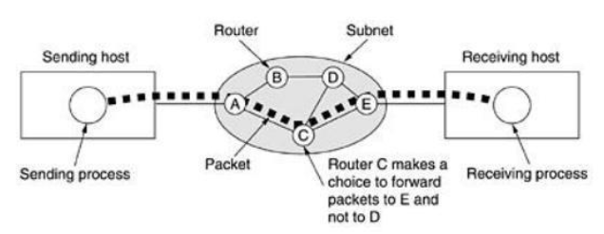
Interconnection of Networks: Internetworks
Two or more networks connected together.
Subnet consists of two components: transmission lines and switching elements.
WAN network contains numerous transmission lines, each one connecting a pair of routers.
Packet Switching followed in WAN.
Dr. Vivek Rajpoot
Unit-1

Slide 21
The Internet
An interconnection of two or more networks
Called the Internet (hundreds of thousands interconnected networks) = Private individuals + government agencies + school + research facilities + Corporations + libraries in more than 100 countries
This communication system came in 1969.
Mid-1960 (ARPA) Advanced Research Projects Agency in (DOD) was interested to connect mainframes in research organizations
1967, ARPA presented its ideas for ARPANET
Host computer connecting to (IMP) interface message processor.
Each IMP communicate with other IMP
1969, four nodes (universities) connected via IMPs to form a network
Software (NCP) Network Control Protocol provided communication b/w the hosts.
1972, Vint Cerf and Bob Kahn invented (TCP) Transmission Control Protocol
Later TCP was split to (TCP) Transmission Control Protocol and (IP) Internet Protocol
Dr. Vivek Rajpoot
Unit-1

Slide 22
Network Models
OSI Model
TCP/IP Model
Dr. Vivek Rajpoot
Unit-1

Slide 23
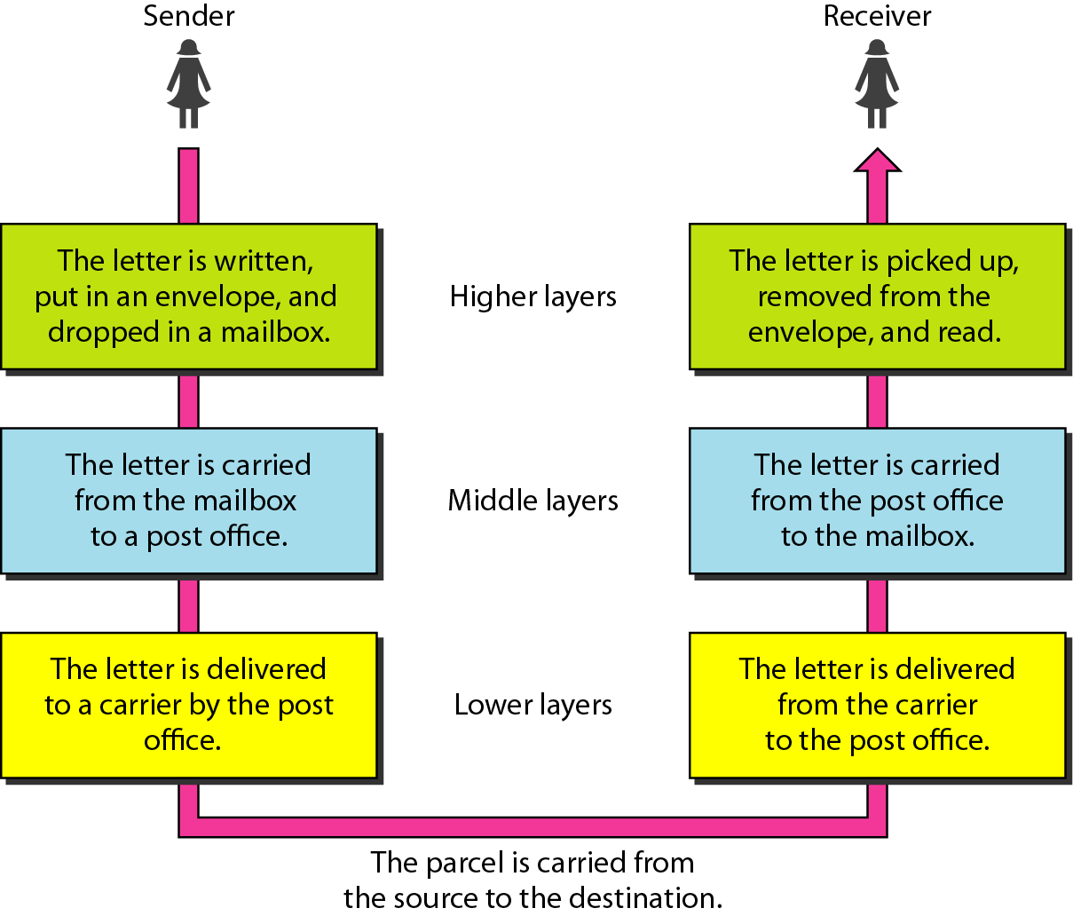
Layered Tasks
We use the concept of layers in our daily life. As an example, let us consider two friends who communicate through postal mail. The process of sending a letter to a friend would be complex if there were no services available from the post office.
Dr. Vivek Rajpoot
Unit-1

Slide 24
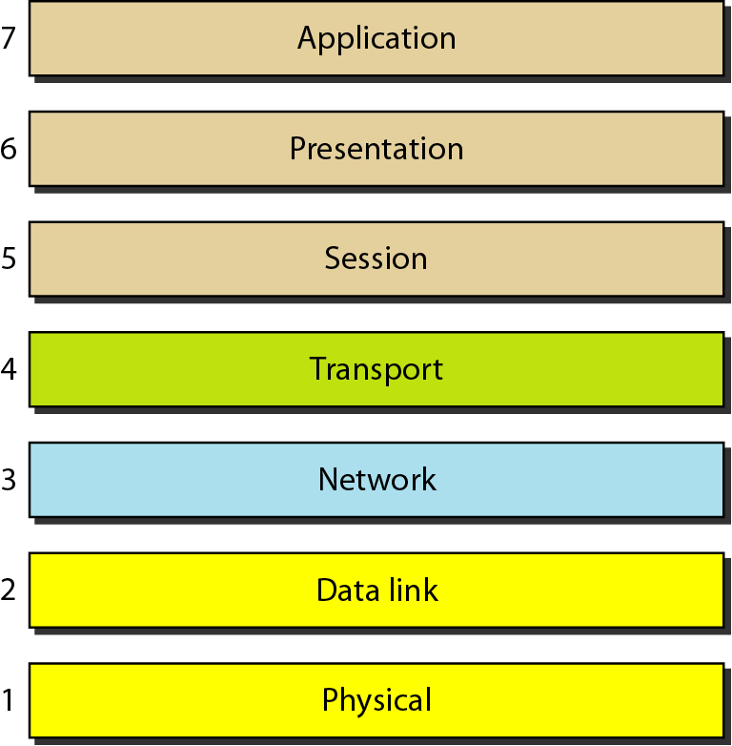
THE OSI MODEL
Established in 1947, the International Standards Organization (ISO) is a multinational body dedicated to worldwide agreement on international standards. An ISO standard that covers all aspects of network communications is the Open Systems Interconnection (OSI) model. It was first introduced in the late 1970s.
ISO is the organization.
OSI is the model.
Dr. Vivek Rajpoot
Unit-1

Slide 25
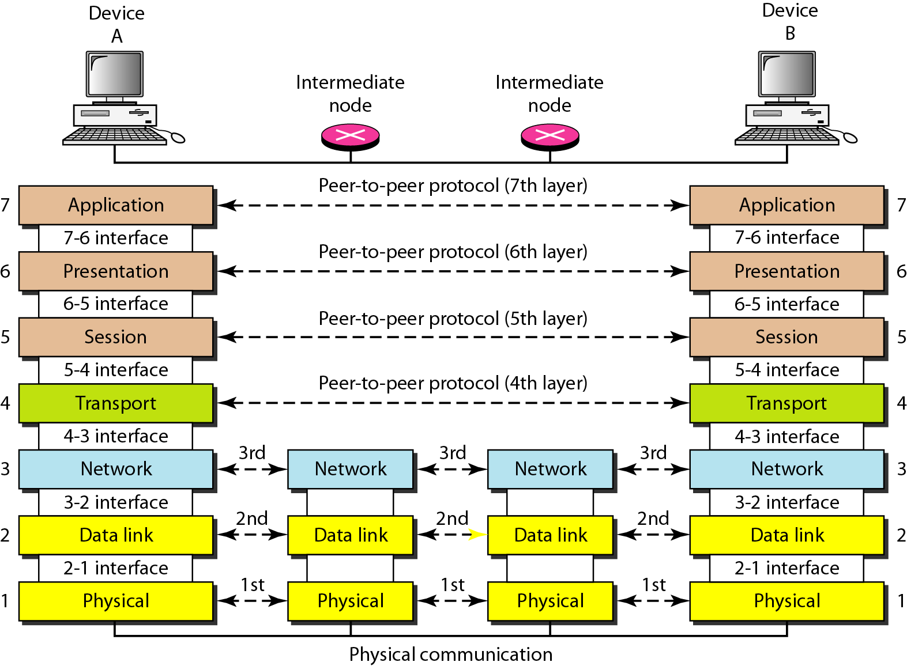
Interaction between layers in the OSI model
Dr. Vivek Rajpoot
Unit-1

Slide 26
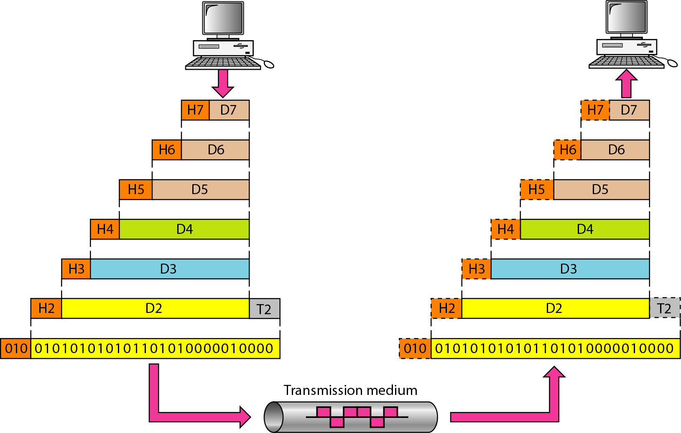
An exchange using the OSI model
Dr. Vivek Rajpoot
Unit-1

Slide 27
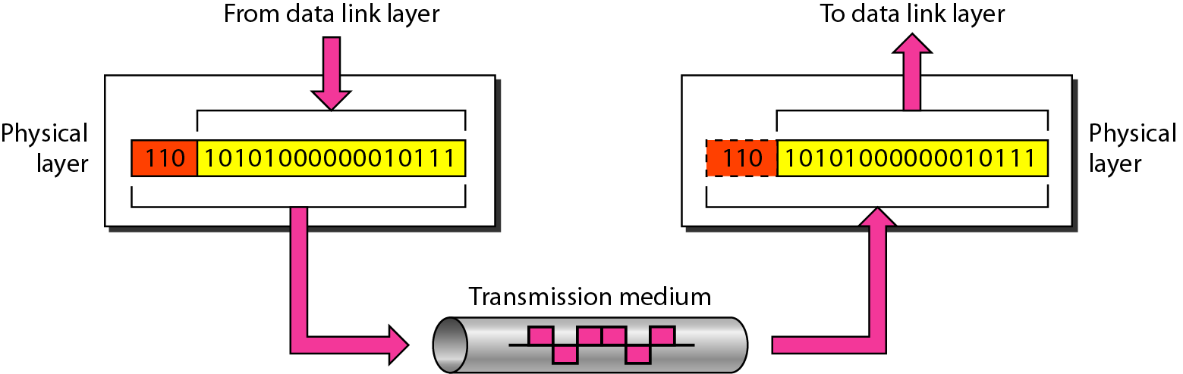
Physical Layer
The physical layer is responsible for movements of individual bits from one hop (node) to the next.
Dr. Vivek Rajpoot
Unit-1

Slide 28
Physical Layer
The physical layer is also concerned with:
Physical characteristics of interfaces and medium: It is responsible for the connection of devices to the medium.
Representation of bits: Its data involves a stream of bits (sequence of 0's and 1's) without any interpretation. To be transmitted bits must be encoded into the signals - electrical or optical.
Data rate: The number of bits sends each second is also defined by the physical layer. In other words, this layer defines the duration of a bit also.
Synchronization of bits: the clocks of the sender and the Rx must be synchronized.
Physical topology: how devices are connected to create a network.
Transmission mode: The mechanism of transferring data or information between two linked devices connected over a network
Dr. Vivek Rajpoot
Unit-1

Slide 29
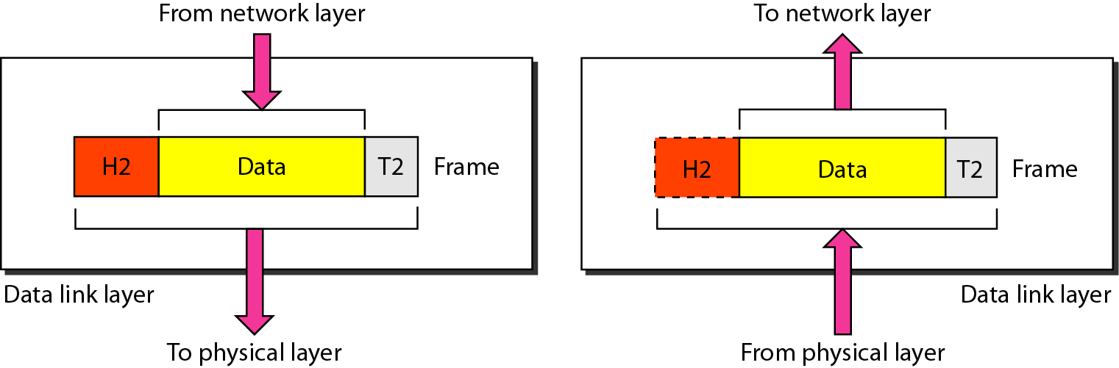
Data-link Layer
The data link layer is responsible for moving frames from one hop (node) to the next.
Dr. Vivek Rajpoot
Unit-1

Slide 30
Responsibilities of Data-link Layer
Framing: It encapsulates each data packet from network layer into frames to transmit.
Physical addressing: After framing, It adds physical addresses (MAC address) of sender and/or receiver in the header of each frame.
Flow Control: Data rate must be constant on both sides else the data may get corrupted thus , flow control coordinates that amount of data that can be sent before receiving acknowledgement.
Error control: It ensures error free link for transmission. It Includes
Dealing with transmission errors
Sending acknowledgement frames in reliable connections
Retransmitting lost frames
Identifying duplicate frames and deleting them
Controlling access to shared channels in case of broadcasting
Access control: When a single communication channel is shared by multiple devices, MAC sub-layer of data link layer helps to determine which device has control over the channel at a given time.
Dr. Vivek Rajpoot
Unit-1

Slide 31
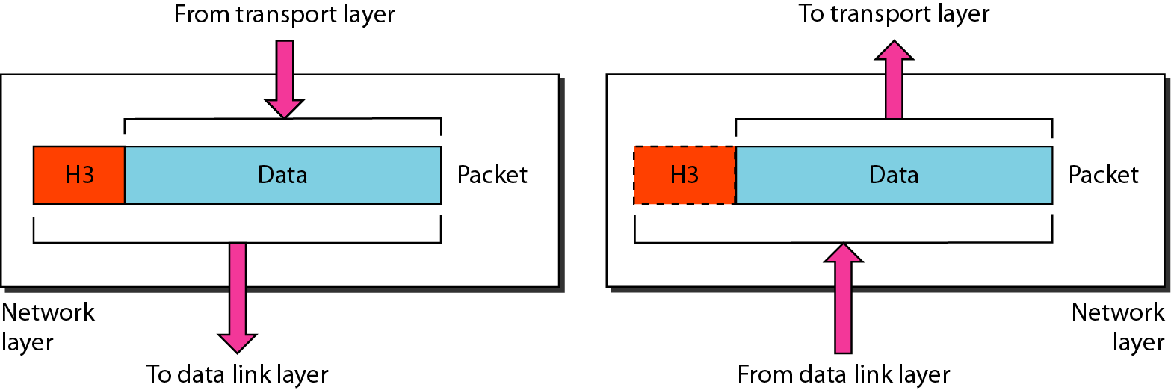
Network layer
The network layer is responsible for the delivery of individual packets from the source host to the destination host.
At the sender side, data is received from the higher layer (transport) and passed down to the lower layer (data link).
At the sender side, data is received from the lower layer (data link) and passed up to the upper layer (transport).
Dr. Vivek Rajpoot
Unit-1

Slide 32
Network layer
If the two systems are attached to different networks with connecting devices between the networks, there is often a need for the network layer to accomplish source-to-destination delivery.
Other responsibilities of network layer include:
Logical addressing: In order to identify each device on internetwork uniquely, network layer defines an addressing scheme. The sender & receiver’s IP address are placed in the header by network layer. Such an address distinguishes each device uniquely and universally.
Routing: The network layer protocols determine which route is suitable from source to destination. This function of network layer is known as routing.
Dr. Vivek Rajpoot
Unit-1

Slide 33
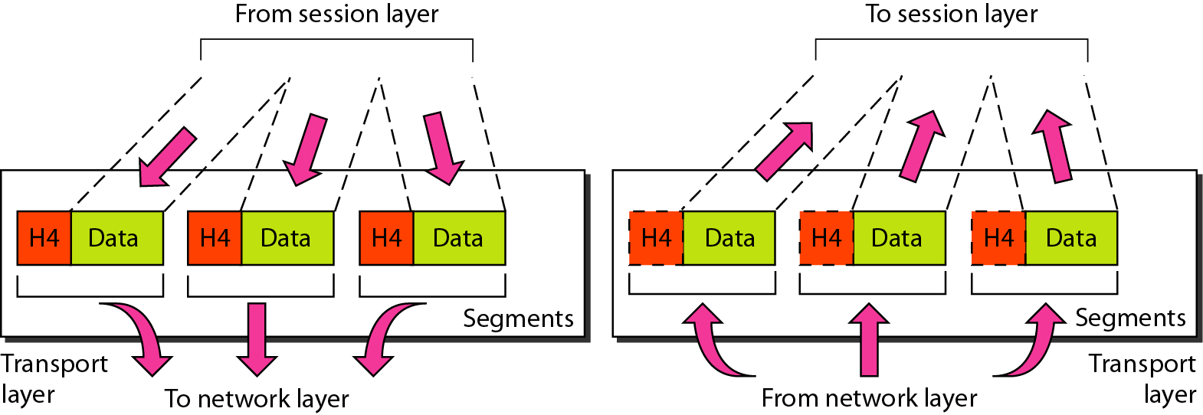
Transport Layer
The transport layer is responsible for the delivery of a message from one process to another.
At the sender side, it receives application data and passes it down to the network layer.
At the receiver side, it receives data from the network layer and passes it up to the appropriate process.
Dr. Vivek Rajpoot
Unit-1

Slide 34
Transport Layer Responsibilities
The transport layer is process-to-process delivery of the entire message.
Other responsibilities of transport layer:
Port addressing: To deliver message to correct process, it’s header includes a type of address called port address. Thus this layer ensures that message is delivered to the correct process.
Segmentation and reassembly: This layer accepts message from session layer , breaks the message into smaller units. Each produced segment has a header associated with it. The transport layer at the destination station reassembles the message.
Connection control:
Connection Oriented Service:
– Connection Establishment – Data Transfer – Termination / disconnection
Flow control
Error control
Dr. Vivek Rajpoot
Unit-1

Slide 35
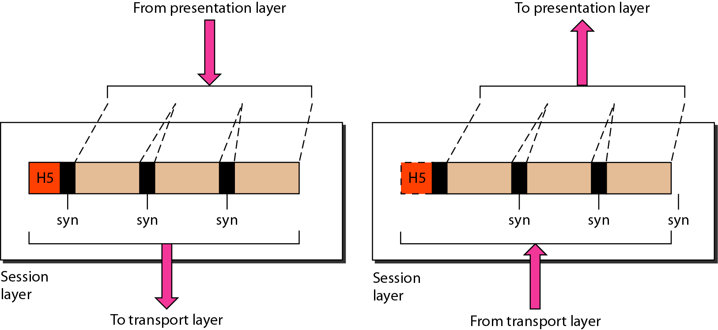
Session Layer
Specific responsibilities of the session layer include:
Dialog control: The session layer allows two systems to start communication with each other in half-duplex or full-duplex.
Session establishment, maintenance and termination: The layer allows the two processes to establish, use and terminate a connection.
Dr. Vivek Rajpoot
Unit-1

Slide 36
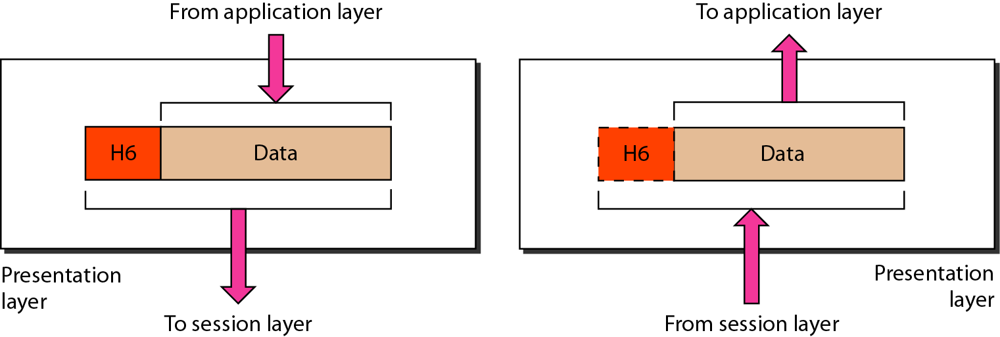
Presentation Layer
Specific responsibilities of presentation layer:
Translation: For example, ASCII to EBCDIC.
Encryption: Data encryption translates the data into another form or code
Compression: Reduces the number of bits that need to be transmitted on the network.
Dr. Vivek Rajpoot
Unit-1

Slide 37
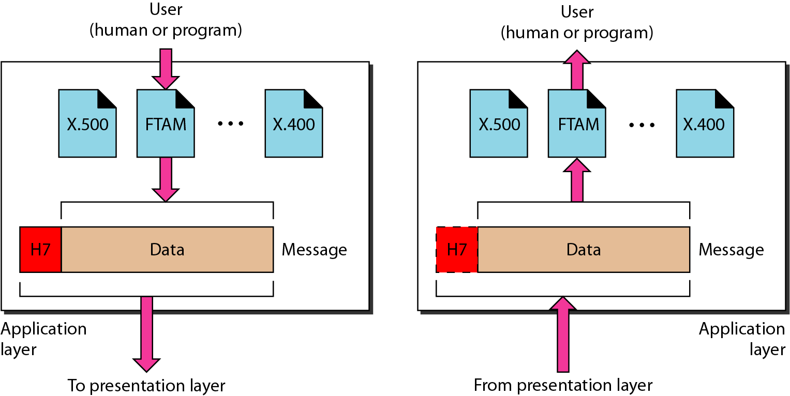
Application Layer
The application layer enables user, weather human or software, to access the network.
It provides user interfaces and support for services such as e-mail, remote file access and transfer, shared database management, and other types of distributed information services.
Dr. Vivek Rajpoot
Unit-1

Slide 38
Application Layer Responsibilities
Hyper Text Transfer Protocol HTTP − It is the underlying protocol for world wide web. It defines how hypermedia messages are formatted and transmitted.
File Transfer Protocol FTP − It is a client-server based protocol for transfer of files between client and server over the network.
Simple Mail Transfer Protocol SMTP − It lays down the rules and semantics for sending and receiving electronic mails (e-mails).
Domain Name System DNS − It is a naming system for devices in networks. It provides services for translating domain names to IP addresses.
TELNET − It provides bi-directional text-oriented services for remote login to the hosts over the network.
Simple Network Management Protocol SNMP − It is for managing, monitoring the network and for organizing information about the networked devices.
Dr. Vivek Rajpoot
Unit-1

Slide 39
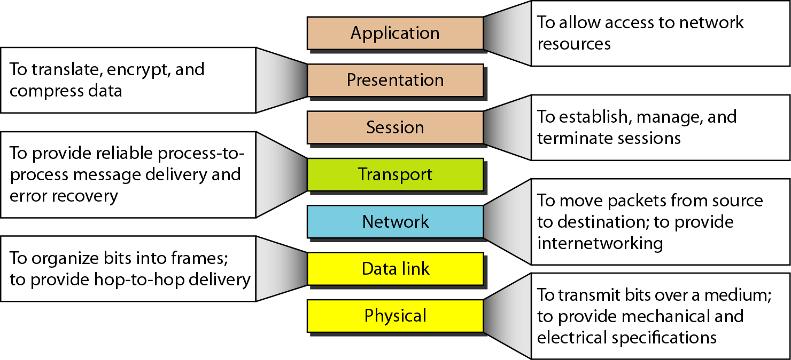
Summary of layers
Dr. Vivek Rajpoot
Unit-1

Slide 40
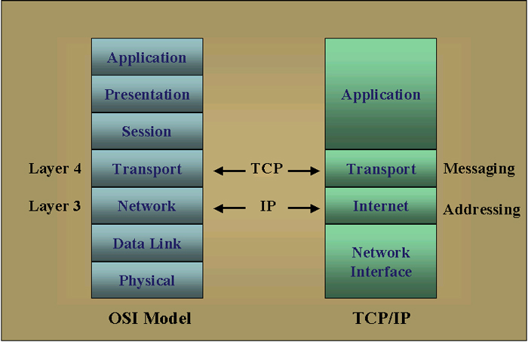
TCP/IP Reference Model
The layers in the TCP/IP protocol suite are not same as OSI model.
The original TCP/IP protocol suite was defined as having four layers: host-to-network, internet, transport, and application.
However, when TCP/IP is compared to OSI, we can say that suite is made of five layers: physical, data link, network, transport, and application.
Dr. Vivek Rajpoot
Unit-1

Slide 41
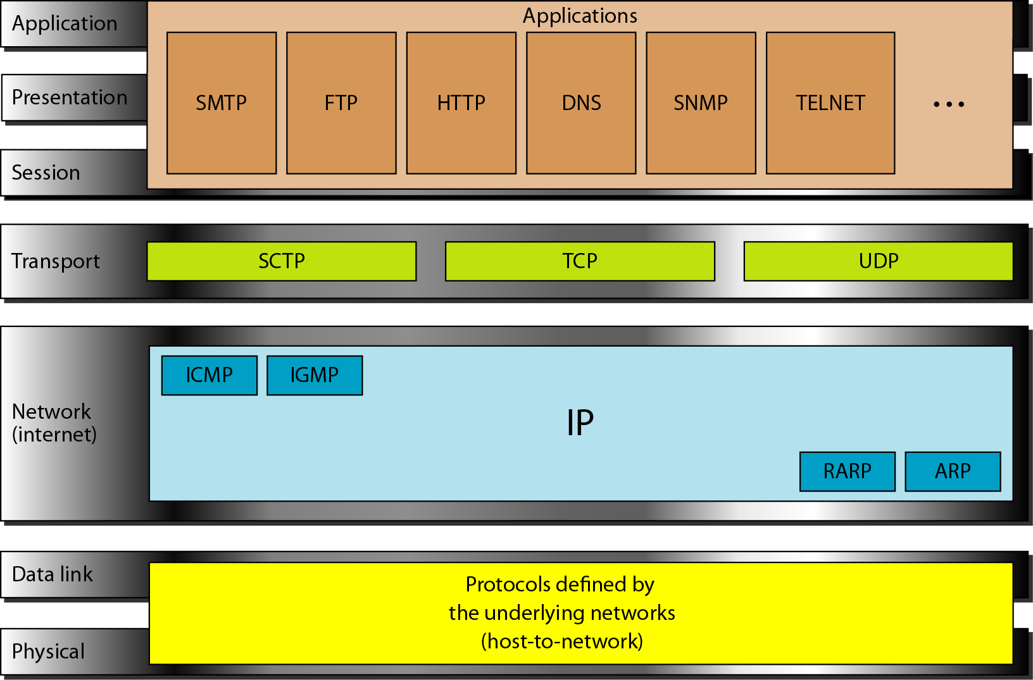
TCP/IP and OSI model Protocols
Dr. Vivek Rajpoot
Unit-1

Slide 42
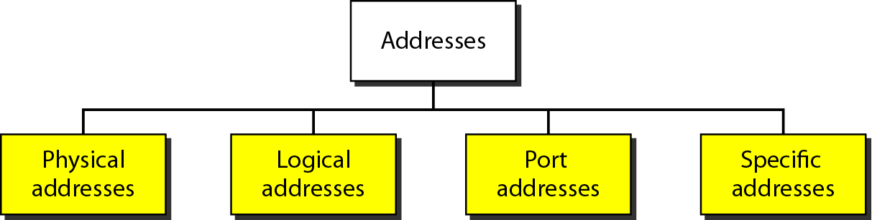
Addresses in TCP/IP; MAC Address
MAC Address: Most local-area networks use a 48-bit (6-byte) physical address written as 12 hexadecimal digits; every byte (2 hexadecimal digits) is separated by a colon, as shown below:
IP ADDRESS:172.34.23.22, PORT ADDRESS: A 16-bit port address represented as one single number
07:01:02:01:2C:4B A 6-byte (12 hexadecimal digits) physical address.
Dr. Vivek Rajpoot
Unit-1

Slide 43
Comparison between OSI and TCP/IP
Similarities between OSI Reference Model and TCP/IP Reference Model
Both have layered architecture.
Layers provide similar functionalities.
Both are protocol stack.
Both are reference models.
Dr. Vivek Rajpoot
Unit-1

Slide 44
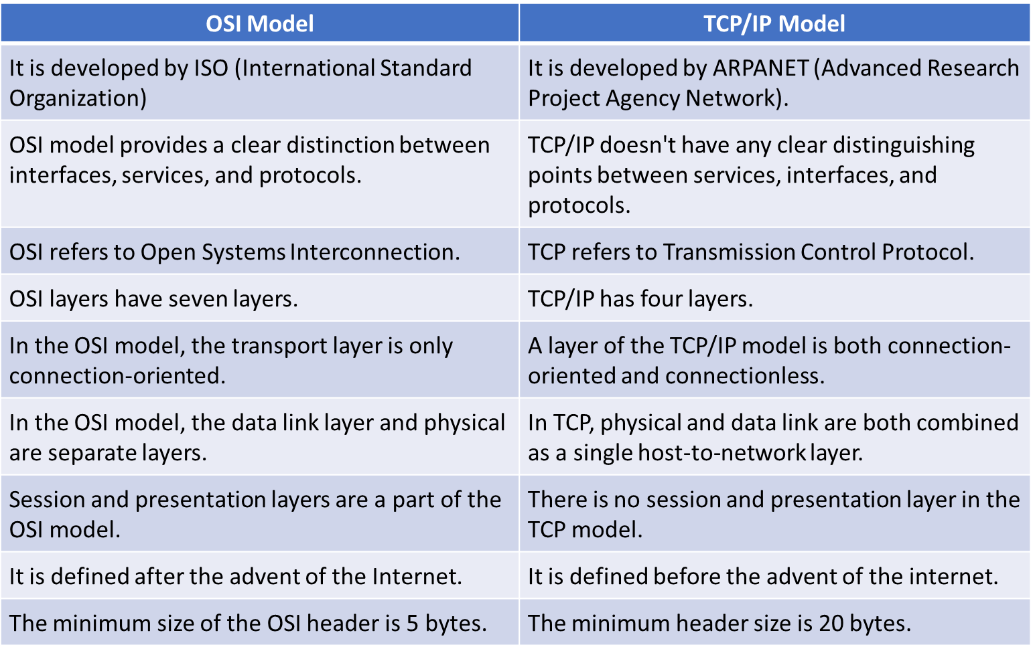
Comparison between OSI and TCP/IP
Dr. Vivek Rajpoot
Unit-1

